Slide 1
Predicting Speakers of General Conference and BYU Speeches
Cason Wight

Slide 2
Outline
Motivation
Data source and structure
Feature Selection/EDA
Modeling choices
Results and comparisons
Conclusion

Slide 3
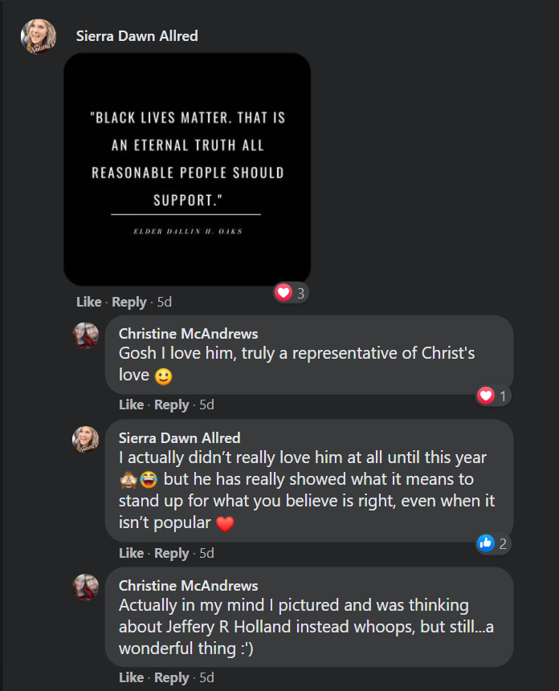
Motivation (from FB)

Slide 4
Motivation (from FB)
Can we recognize a speaker from a single quote?
How good can predictions like this be?
Are speakers noticeably different from one year to the next?

Slide 5
Motivation (from FB)
Can we recognize a speaker from a single quote?
How good can predictions like this be?
Are speakers noticeably different from one year to the next?

Slide 6
Motivation (from FB)
Can we recognize a speaker from a single quote?
How good can predictions like this be?
Are speakers noticeably different from one year to the next?

Slide 7
Data
Speakers
1st Presidency
Members of the Quorum of the 12
General Conference talks
Since 1978
Web scraped from churchofjesuschrist.org/
BYU Speeches
Since 1973
Web scraped from speeches.byu.edu/
All talks/speeches are split up into paragraphs

Slide 8
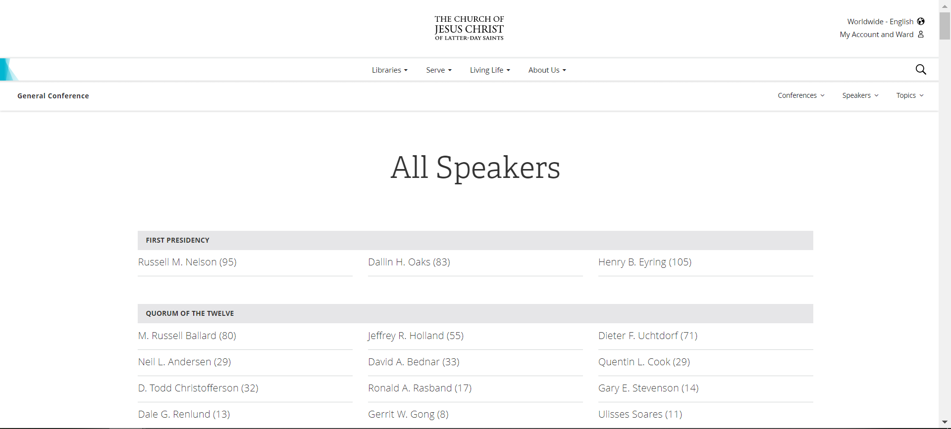
General Conference Talks

Slide 9
General Conference Talks
<div class="lumen-tile lumen-tile--horizontal lumen-tile--list lumen-layout__item">
<div class="lumen-tile__text-wrapper">
<div class="lumen-tile__title">
<a href="/general-conference/speakers?speaker=%2Fchurch%2Fleader%2Frussell-m-nelson&amp;lang=eng“
Russell M. Nelson (95)
</a>
</div>
</div>
</div>

Slide 10
General Conference Talks
<div class="lumen-tile lumen-tile--horizontal lumen-tile--list lumen-layout__item">
<div class="lumen-tile__text-wrapper">
<div class="lumen-tile__title">
<a href="/general-conference/speakers?speaker=%2Fchurch%2Fleader%2Frussell-m-nelson&amp;lang=eng“
Russell M. Nelson (95)
</a>
</div>
</div>
</div>

Slide 11
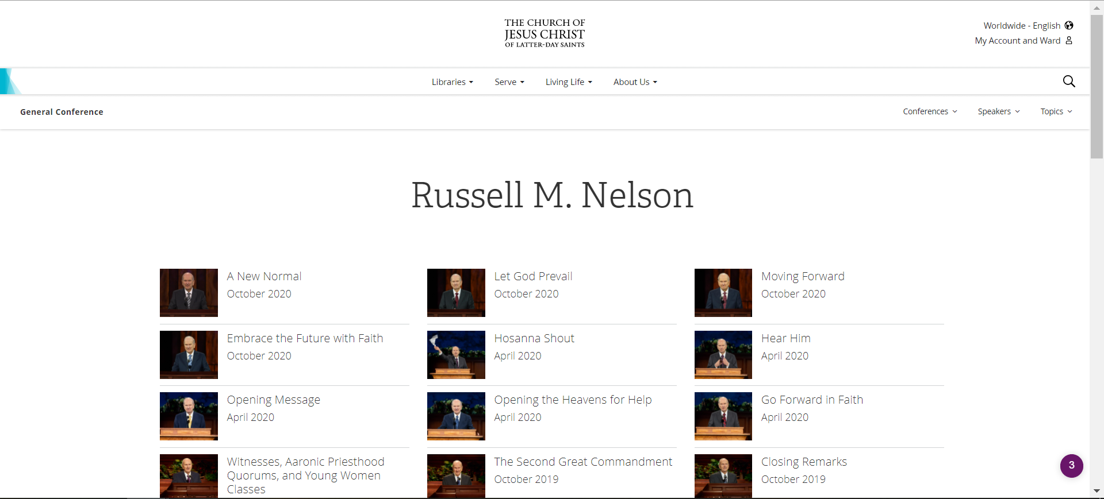
General Conference Talks

Slide 12
General Conference Talks
<a href="/general-conference/2020/10/58nelson?lang=eng" class="lumen-tile__link">
<div class="lumen-tile__image-wrapper"> …
</div>
<div class="lumen-tile__text-wrapper">
<div class="lumen-tile__title">
A New Normal
</div>
<div class="lumen-tile__content">October 2020</div>
</div>
</a>

Slide 13
General Conference Talks
<a href="/general-conference/2020/10/58nelson?lang=eng" class="lumen-tile__link">
<div class="lumen-tile__image-wrapper"> …
</div>
<div class="lumen-tile__text-wrapper">
<div class="lumen-tile__title">
A New Normal
</div>
<div class="lumen-tile__content">October 2020</div>
</div>
</a>

Slide 14
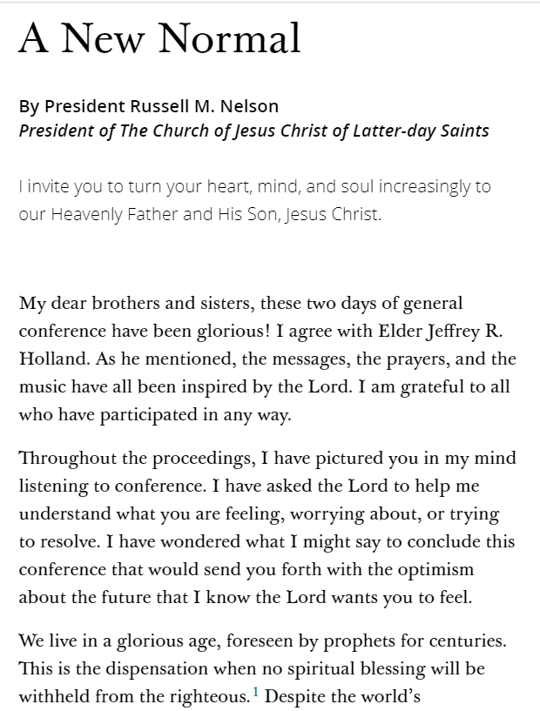
General Conference Talks

Slide 15
General Conference Talks
<p data-aid="144620494" id="p1" style="--height:142.222px;">
My dear brothers and sisters, these two days of general conference have been
glorious! I agree with Elder Jeffrey&nbsp;R. Holland. As he mentioned, the
messages, the prayers, and the music have all been inspired by the Lord. I
am grateful to all who have participated in any way.
</p>

Slide 16
General Conference Talks
<p data-aid="144620494" id="p1" style="--height:142.222px;">
My dear brothers and sisters, these two days of general conference have been
glorious! I agree with Elder Jeffrey&nbsp;R. Holland. As he mentioned, the
messages, the prayers, and the music have all been inspired by the Lord. I
am grateful to all who have participated in any way.
</p>

Slide 17
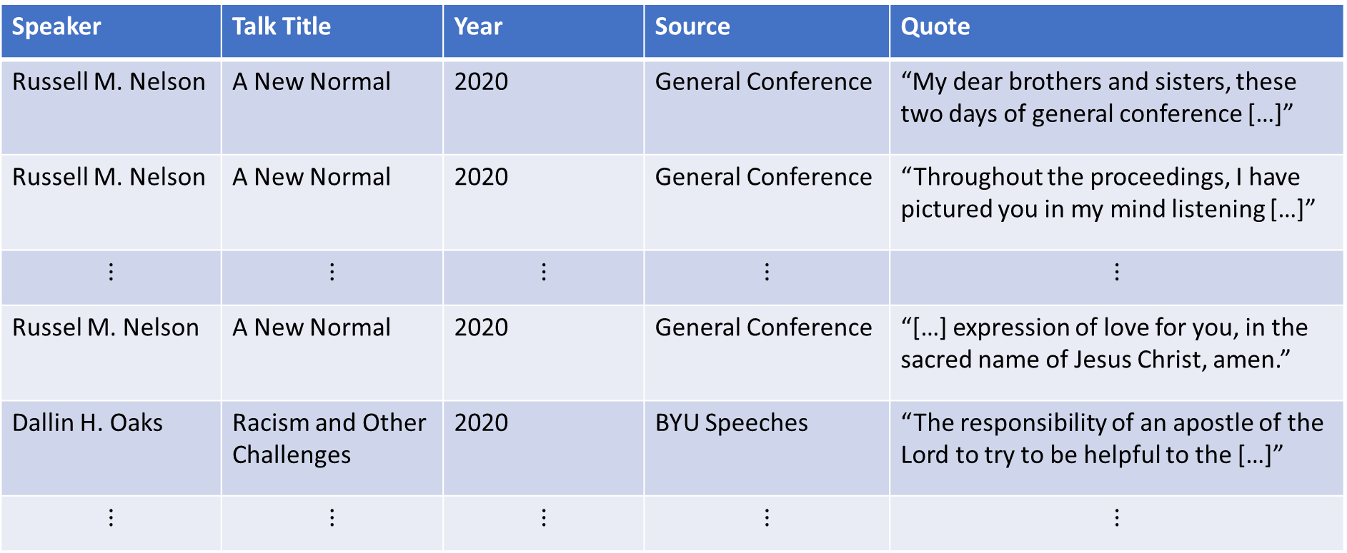
Quotes Data Format (34,066 quotes)
Speaker | Talk Title | Year | Source | Quote
Russell M. Nelson | A New Normal | 2020 | General Conference | “My dear brothers and sisters, these two days of general conference […]”
Russell M. Nelson | A New Normal | 2020 | General Conference | “Throughout the proceedings, I have pictured you in my mind listening […]”
$$⋮$$ | $$⋮$$ | $$⋮$$ | $$⋮$$ | $$⋮$$
Russel M. Nelson | A New Normal | 2020 | General Conference | “[…] expression of love for you, in the sacred name of Jesus Christ, amen.”
Dallin H. Oaks | Racism and Other Challenges | 2020 | BYU Speeches | “The responsibility of an apostle of the Lord to try to be helpful to the […]”
$$⋮$$ | $$⋮$$ | $$⋮$$ | $$⋮$$ | $$⋮$$

Slide 18
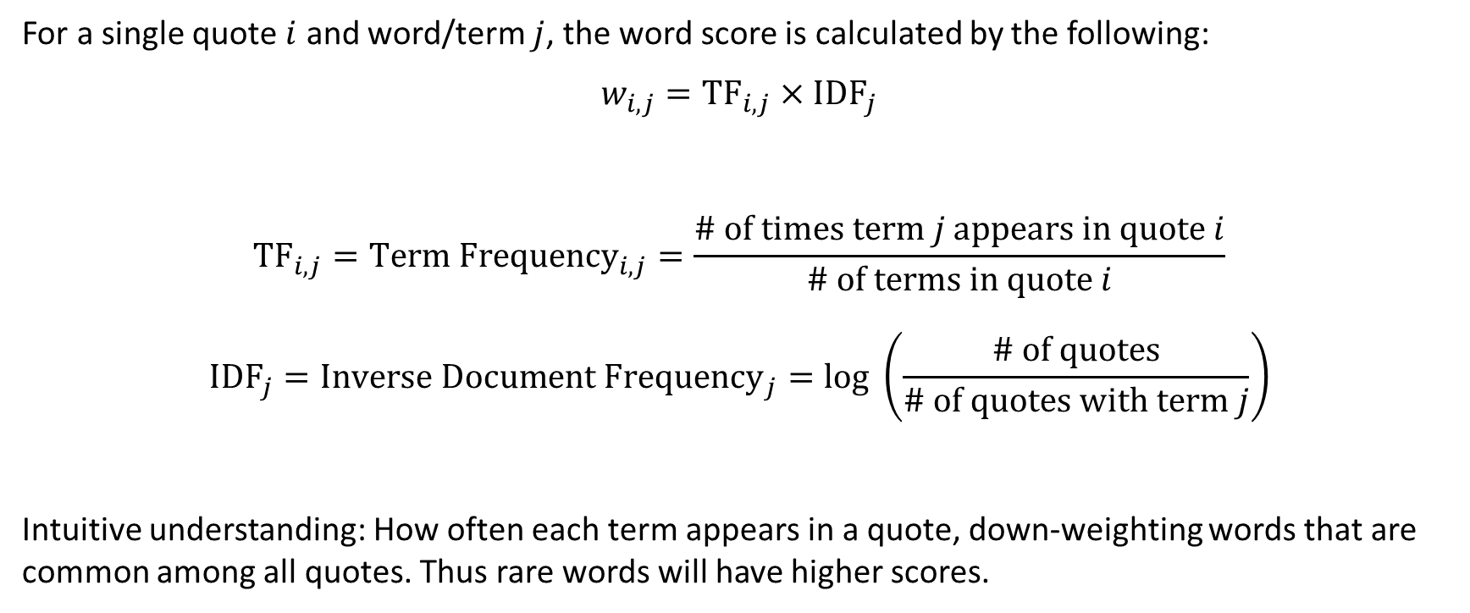
Feature Selection: TF-IDF Word Score
For a single quote $i$ and word/term $j$, the word score is calculated by the following:
$$w_{i,j}={TF}_{i,j}×{IDF}_{j}$$
$${TF}_{i,j}={Term Frequency}_{i,j}=\frac{\# of times term j appears in quote i}{\# of terms in quote i}$$
$${IDF}_{j}={Inverse Document Frequency}_{j}=log \left(\frac{\# of quotes}{\# of quotes with term j}\right)$$
Intuitive understanding: How often each term appears in a quote, down-weighting words that are common among all quotes. Thus rare words will have higher scores.

Slide 19

What counts as a term?
Toy quotes:
“Along with Relief Society, the Elder’s Quorum brings relief to those in need.”
“The Relief Society is a good organization.”
Simple Tokenization:
First step is to “clean” the quotes:
“The Relief Society is a good organization.” $→$ “relief society good organization”
Using $n$-grams (2-grams in this example):
Then split the quote (simple tokenization):
“relief society good organization” $→\begin{matrix}relief & society & good & organization \\ [1 & 1 & 1 & 1]\end{matrix}$

Slide 20
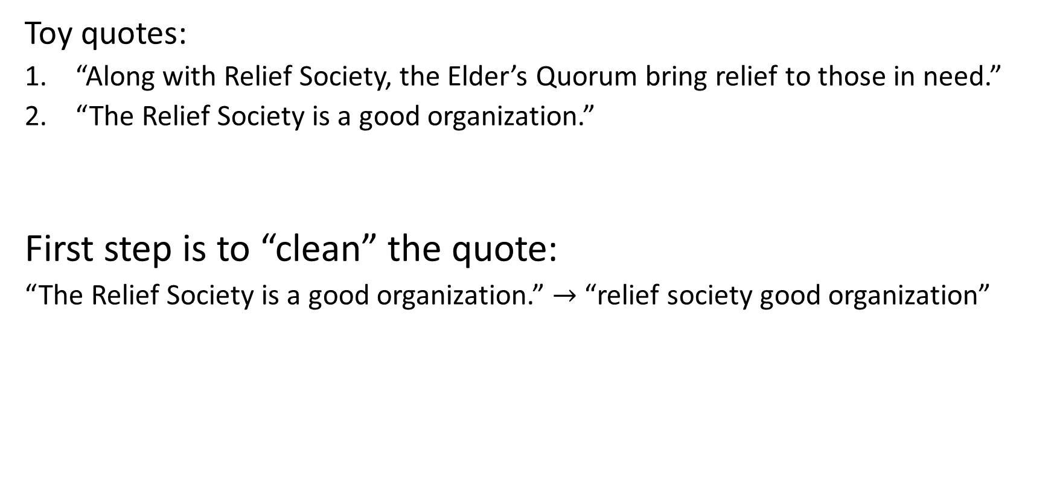
What counts as a term?
Toy quotes:
“Along with Relief Society, the Elder’s Quorum bring relief to those in need.”
“The Relief Society is a good organization.”
Simple Tokenization:
First step is to “clean” the quote:
“The Relief Society is a good organization.” $→$ “relief society good organization”
Using $n$-grams (2-grams in this example):
Then split the quote (simple tokenization):
“relief society good organization” $→\begin{matrix}relief & society & good & organization \\ [1 & 1 & 1 & 1]\end{matrix}$

Slide 21
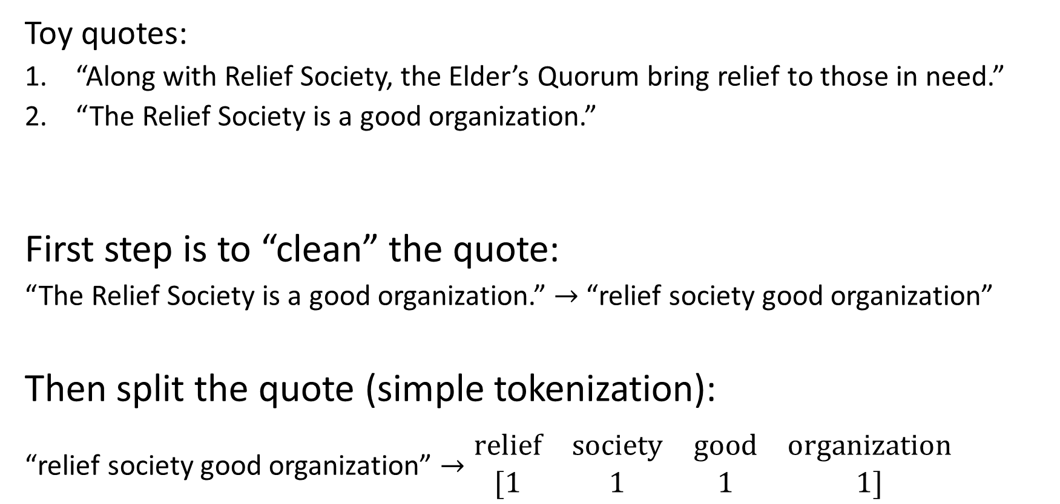
What counts as a term?
Toy quotes:
“Along with Relief Society, the Elder’s Quorum bring relief to those in need.”
“The Relief Society is a good organization.”
Simple Tokenization:
First step is to “clean” the quote:
“The Relief Society is a good organization.” $→$ “relief society good organization”
Using $n$-grams (2-grams in this example):
Then split the quote (simple tokenization):
“relief society good organization” $→\begin{matrix}relief & society & good & organization \\ [1 & 1 & 1 & 1]\end{matrix}$

Slide 22

What counts as a term?
Toy quotes:
“Along with Relief Society, the Elder’s Quorum bring relief to those in need.”
“The Relief Society is a good organization.”
Simple Tokenization:
First step is to “clean” the quotes:
“The Relief Society is a good organization.” $→$ “relief society good organization”
Using $n$-grams (2-grams in this example):
Then split the quote (simple tokenization):
“relief society good organization” $→\begin{matrix}relief & society & good & organization \\ [1 & 1 & 1 & 1]\end{matrix}$
along | relief | society | elders | quorum | bring | those | need | good | organization
1 | 2 | 1 | 1 | 1 | 1 | 1 | 1 | 0 | 0
0 | 1 | 1 | 0 | 0 | 0 | 0 | 0 | 1 | 1

Slide 23

What counts as a term?
Toy quotes:
“Along with Relief Society, the Elder’s Quorum bring relief to those in need.”
“The Relief Society is a good organization.”
Simple Tokenization:
First step is to “clean” the quotes:
“The Relief Society is a good organization.” $→$ “relief society good organization”
Using $n$-grams (2-grams in this example):
Then split the quote (simple tokenization):
“relief society good organization” $→\begin{matrix}relief & society & good & organization \\ [1 & 1 & 1 & 1]\end{matrix}$
along | relief | society | elders | quorum | bring | those | need | good | organization
1 | 2 | 1 | 1 | 1 | 1 | 1 | 1 | 0 | 0
0 | 1 | 1 | 0 | 0 | 0 | 0 | 0 | 1 | 1
along relief | relief society | society elders | elders quorum | quorum bring | bring relief | relief those | those need | society good | good organization
1 | 1 | 1 | 1 | 1 | 1 | 1 | 1 | 0 | 0
0 | 1 | 0 | 0 | 0 | 0 | 0 | 0 | 1 | 1

Slide 24

What counts as a term?
Toy quotes:
“Along with Relief Society, the Elder’s Quorum bring relief to those in need.”
“The Relief Society is a good organization.”
Simple Tokenization:
First step is to “clean” the quotes:
“The Relief Society is a good organization.” $→$ “relief society good organization”
Using $n$-grams (2-grams in this example):
Then split the quote (simple tokenization):
“relief society good organization” $→\begin{matrix}relief & society & good & organization \\ [1 & 1 & 1 & 1]\end{matrix}$
along | relief | society | elders | quorum | bring | those | need | good | organization
1 | 2 | 1 | 1 | 1 | 1 | 1 | 1 | 0 | 0
0 | 1 | 1 | 0 | 0 | 0 | 0 | 0 | 1 | 1
along relief | relief society | society elders | elders quorum | quorum bring | bring relief | relief those | those need | society good | good organization
1 | 1 | 1 | 1 | 1 | 1 | 1 | 1 | 0 | 0
0 | 1 | 0 | 0 | 0 | 0 | 0 | 0 | 1 | 1

Slide 25

What counts as a term?
Toy quotes:
“Along with Relief Society, the Elder’s Quorum bring relief to those in need.”
“The Relief Society is a good organization.”
Simple Tokenization:
First step is to “clean” the quotes:
“The Relief Society is a good organization.” $→$ “relief society good organization”
Using $n$-grams (2-grams in this example):
Then split the quote (simple tokenization):
“relief society good organization” $→\begin{matrix}relief & society & good & organization \\ [1 & 1 & 1 & 1]\end{matrix}$
along | relief | society | elders | quorum | bring | those | need | good | organization
1 | 2 | 1 | 1 | 1 | 1 | 1 | 1 | 0 | 0
0 | 1 | 1 | 0 | 0 | 0 | 0 | 0 | 1 | 1
along relief | relief society | society elders | elders quorum | quorum bring | bring relief | relief those | those need | society good | good organization
1 | 1 | 1 | 1 | 1 | 1 | 1 | 1 | 0 | 0
0 | 1 | 0 | 0 | 0 | 0 | 0 | 0 | 1 | 1

Slide 26

What counts as a term?
Toy quotes:
“Along with Relief Society, the Elder’s Quorum bring relief to those in need.”
“The Relief Society is a good organization.”
Simple Tokenization:
First step is to “clean” the quotes:
“The Relief Society is a good organization.” $→$ “relief society good organization”
Using $n$-grams (2-grams in this example):
Then split the quote (simple tokenization):
“relief society good organization” $→\begin{matrix}relief & society & good & organization \\ [1 & 1 & 1 & 1]\end{matrix}$
along | relief | society | elders | quorum | bring | those | need | good | organization
1 | 2 | 1 | 1 | 1 | 1 | 1 | 1 | 0 | 0
0 | 1 | 1 | 0 | 0 | 0 | 0 | 0 | 1 | 1
along relief | relief society | society elders | elders quorum | quorum bring | bring relief | relief those | those need | society good | good organization
1 | 1 | 1 | 1 | 1 | 1 | 1 | 1 | 0 | 0
0 | 1 | 0 | 0 | 0 | 0 | 0 | 0 | 1 | 1

Slide 27
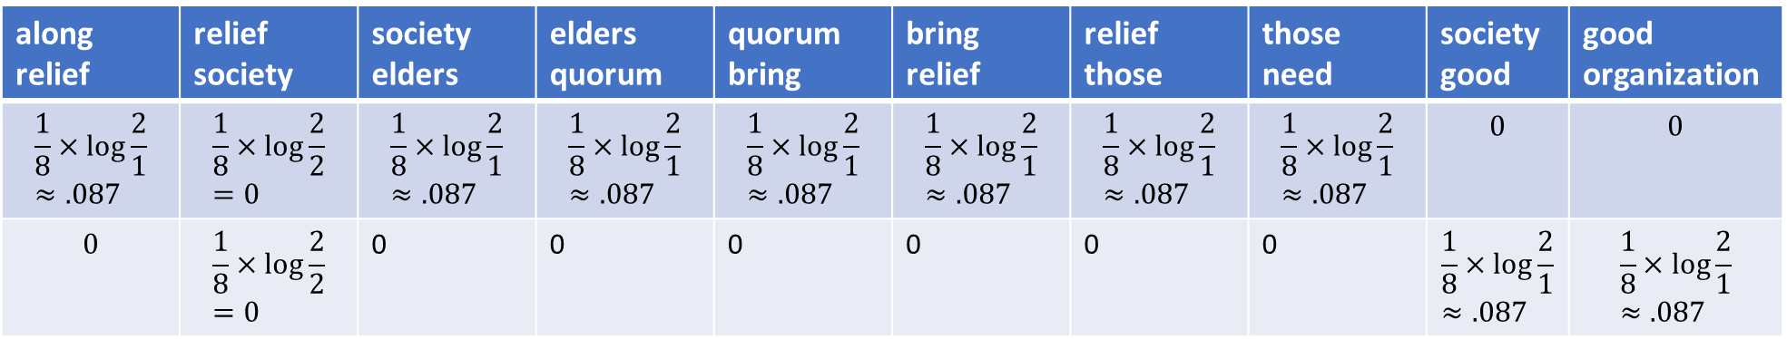

TF-IDF Example
2-gram counts
$$↓$$
TF-IDF values
along relief | relief society | society elders | elders quorum | quorum bring | bring relief | relief those | those need | society good | good organization
1 | 1 | 1 | 1 | 1 | 1 | 1 | 1 | 0 | 0
0 | 1 | 0 | 0 | 0 | 0 | 0 | 0 | 1 | 1
along relief | relief society | society elders | elders quorum | quorum bring | bring relief | relief those | those need | society good | good organization
$$\frac{1}{8}×\log{\frac{2}{1}}≈.087$$ | $$\frac{1}{8}×\log{\frac{2}{2}}=0$$ | $$\frac{1}{8}×\log{\frac{2}{1}}≈.087$$ | $$\frac{1}{8}×\log{\frac{2}{1}}≈.087$$ | $$\frac{1}{8}×\log{\frac{2}{1}}≈.087$$ | $$\frac{1}{8}×\log{\frac{2}{1}}≈.087$$ | $$\frac{1}{8}×\log{\frac{2}{1}}≈.087$$ | $$\frac{1}{8}×\log{\frac{2}{1}}≈.087$$ | $$0$$ | $$0$$
$$0$$ | $$\frac{1}{8}×\log{\frac{2}{2}}=0$$ | 0 | 0 | 0 | 0 | 0 | 0 | $$\frac{1}{8}×\log{\frac{2}{1}}≈.087$$ | $$\frac{1}{8}×\log{\frac{2}{1}}≈.087$$

Slide 28
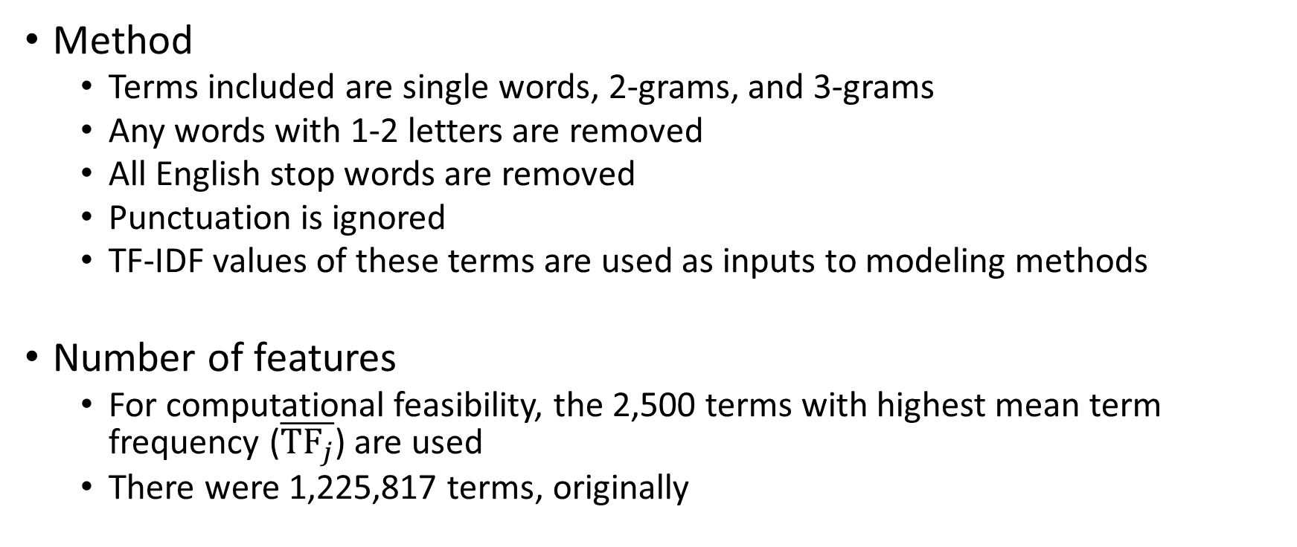
Feature Selection Details
Method
Terms included are single words, 2-grams, and 3-grams
Any words with 1-2 letters are removed
All English stop words are removed
Punctuation is ignored
TF-IDF values of these terms are used as inputs to modeling methods
Number of features
For computational feasibility, the 2,500 terms with highest mean term frequency ($\overline{{TF}_{j}}$) are used
There were 1,225,817 terms, originally

Slide 29
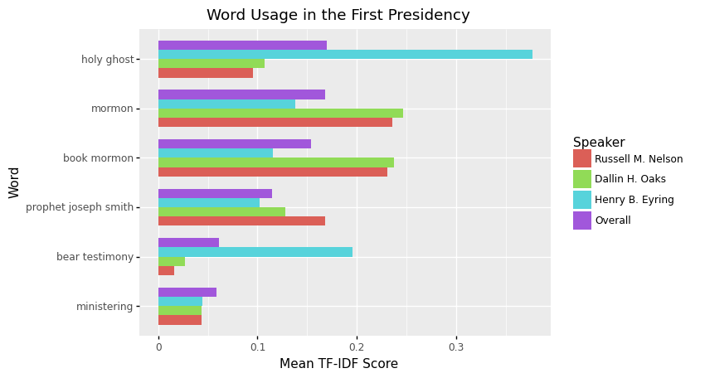

Slide 30
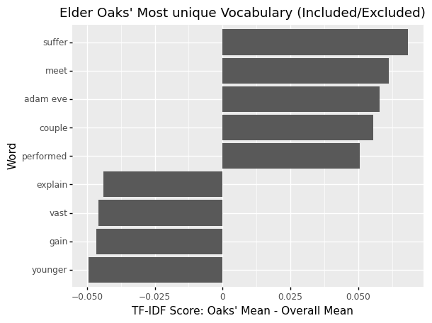

Slide 31
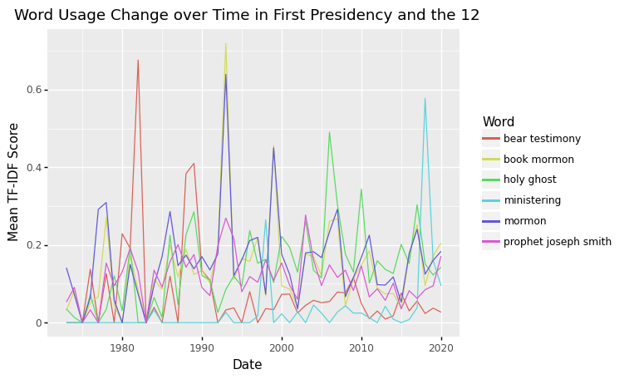

Slide 32
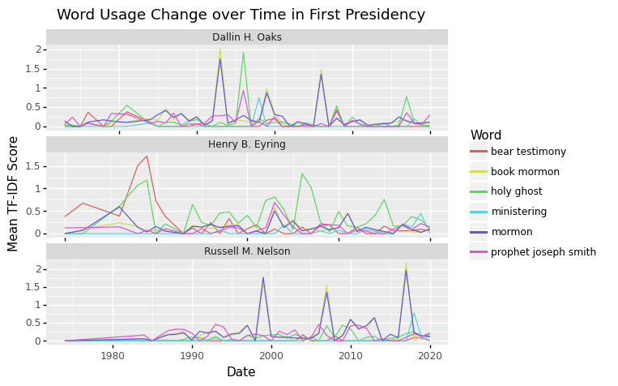

Slide 33
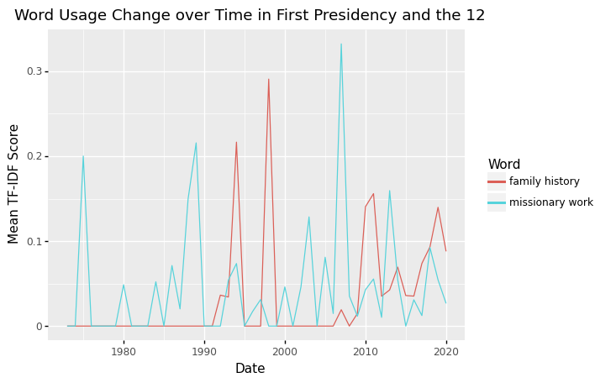

Slide 34
